Slide 1
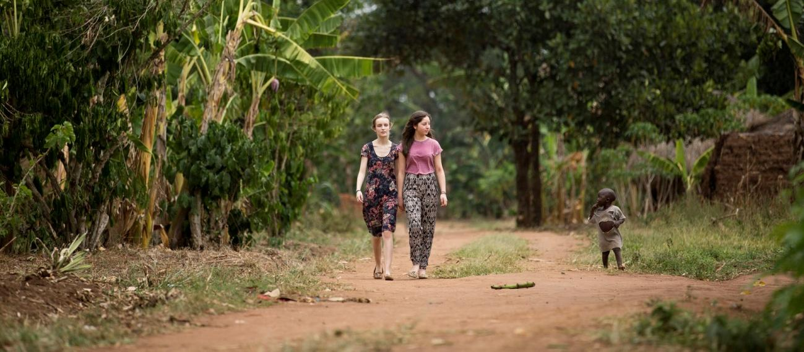
Young Ambassadors
Uganda 2014

Slide 2
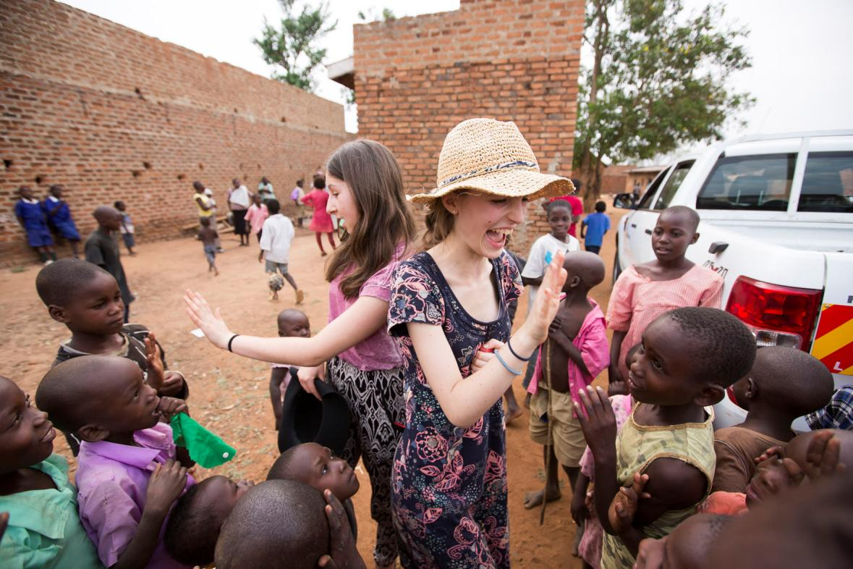
Maisie le Masurier and Rebecca Unwin – the 2014 Young Ambassadors for the Send My Friend to School campaign – visited Uganda in February to find out about the challenges children with disabilities face in getting an education.

Slide 3
Day 1:
Arriving in Uganda!

Slide 4
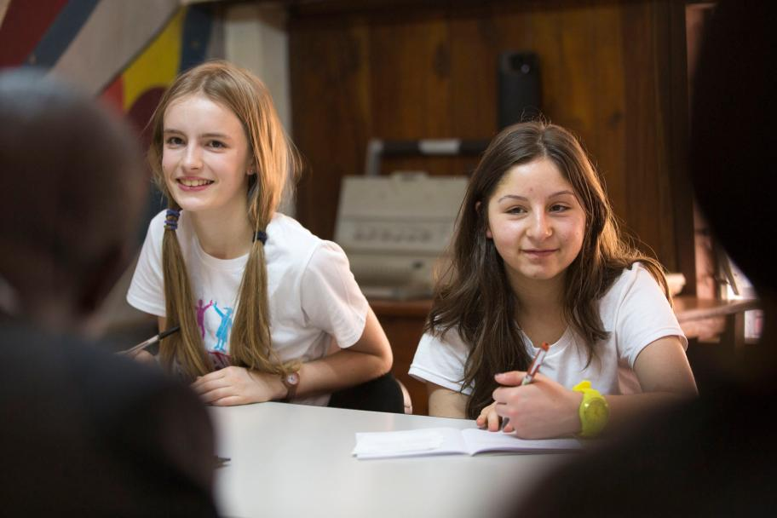
After a long journey…we arrived in Uganda, greeted by sunshine! Travelling through the capital, Kampala, we got a glimpse of Ugandan culture and way of life.
We met with Juliet, who works for the charity Sightsavers.
She made us feel very welcome, and spoke to us about the challenges facing children with disabilities in Uganda.

Slide 5
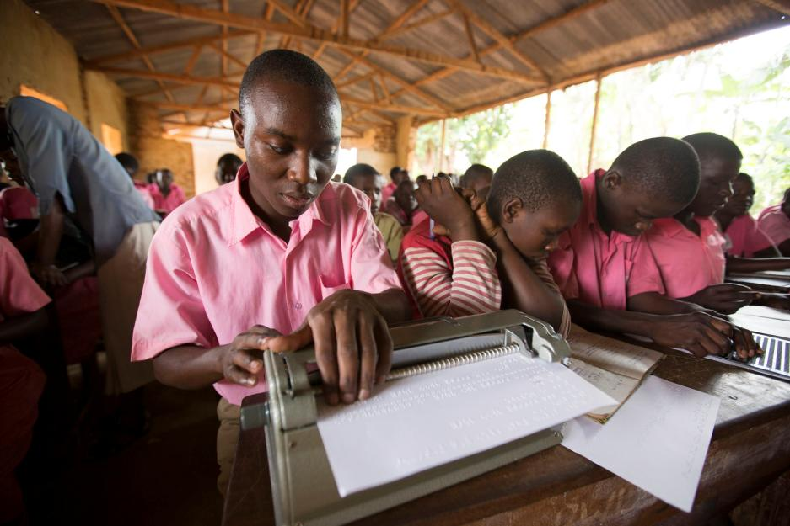
We learned that in Uganda:
About one fifth of primary school aged children don’t go to school.
Many children have disabilities – including problems with eyesight or mobility.
Some of the challenges include:
A shortage of teachers in schools
Big class sizes making it harder to learn
A lack of training for teachers in special needs
Negative attitudes towards children with special needs – and their teachers.

Slide 6
Day 2:
Hearing about advocacy work

Slide 7
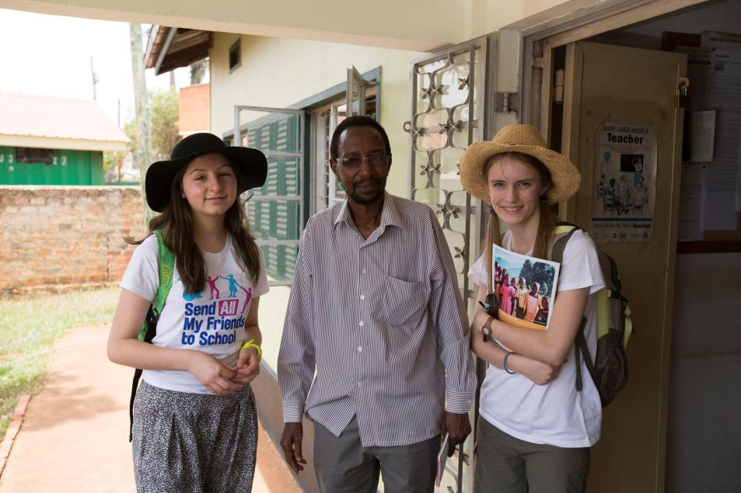
On our second day in Uganda, we met organisations doing important work to improve education for children with disabilities in Uganda.
Fred from the Forum for Education NGOs in Uganda (FENU) told us that there was a gap between what is promised, and what happens in practice.
He explained that better learning resources are needed for children with disabilities, and the government needs to invest more money in education.

Slide 8

Meeting inspiring young campaigners
We also met three visually impaired young campaigners from Uganda National Association for the Blind. They told us that it is very hard for children with disabilities to get an education, and often parents cannot afford the extra costs and materials needed.
We were very inspired by the great campaigning they are doing in Uganda.

Slide 9
Day 3:
Children in rural Iganga

Slide 10
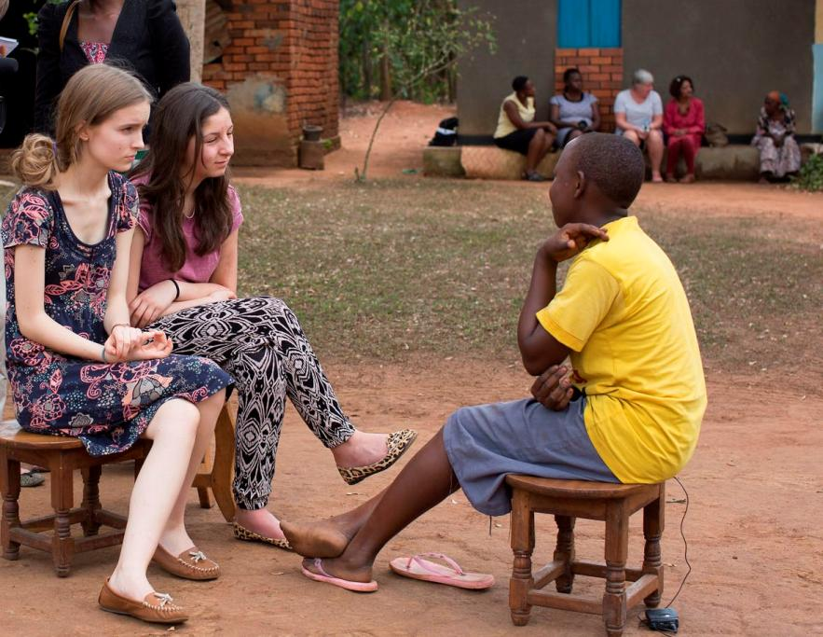
Meeting Eva
On our third day in Uganda, we met 16-year-old Eva, who lives in a rural area called Iganga.
Eva told us that she had to drop out of school because of problems with her vision.
She wanted to become a doctor, but the local school cannot support her learning needs.

Slide 11
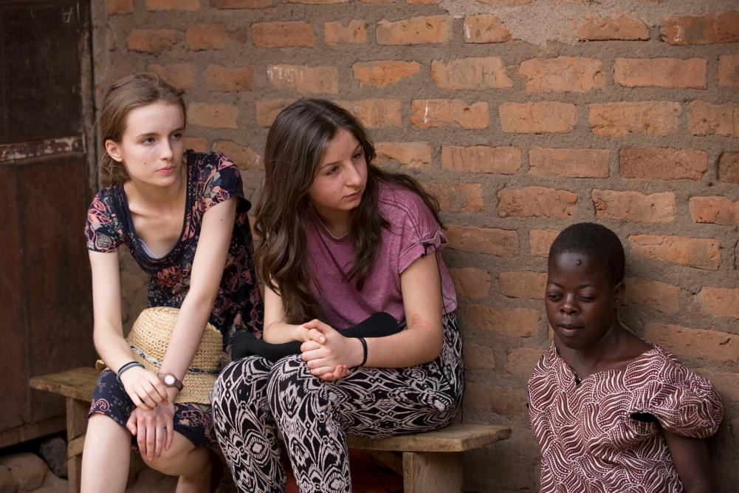
Meeting Nabirye
We also met Nabirye, aged 15. She told us that she had to drop out of school when she was 10 because she couldn’t see the chalkboard. Her school was not able to help her.
It was eye-opening to see the contrast between the happy children playing with their school friends and Nabirye, who felt isolated.

Slide 12
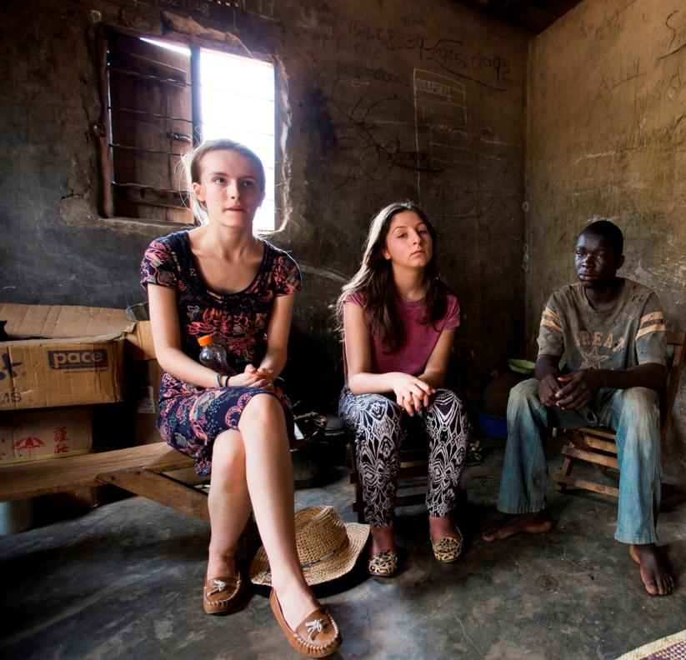
Meeting Hamza
We then met 17-year-old Hamza, who is blind. His family cannot afford the fees at schools that are equipped for visually impaired children.
Hamza’s father is also blind, and struggles to support the family.
Meeting these children was upsetting, but filled us with more motivation to help change the situation.

Slide 13
Day 4:
Inclusive schools

Slide 14
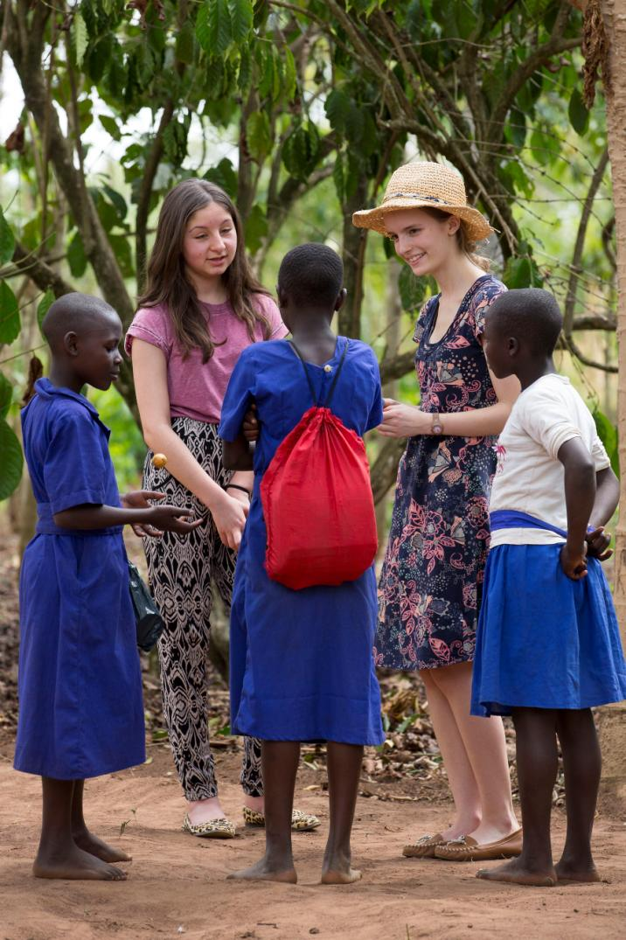
On our fourth day, we visited the friendly Bishop Willis Primary School in Iganga.
56 visually impaired children attend the school, and learn side by side in classes with sighted children. They also regularly visit a visual impairment unit for further support.
It was a great example of inclusive education.

Slide 15
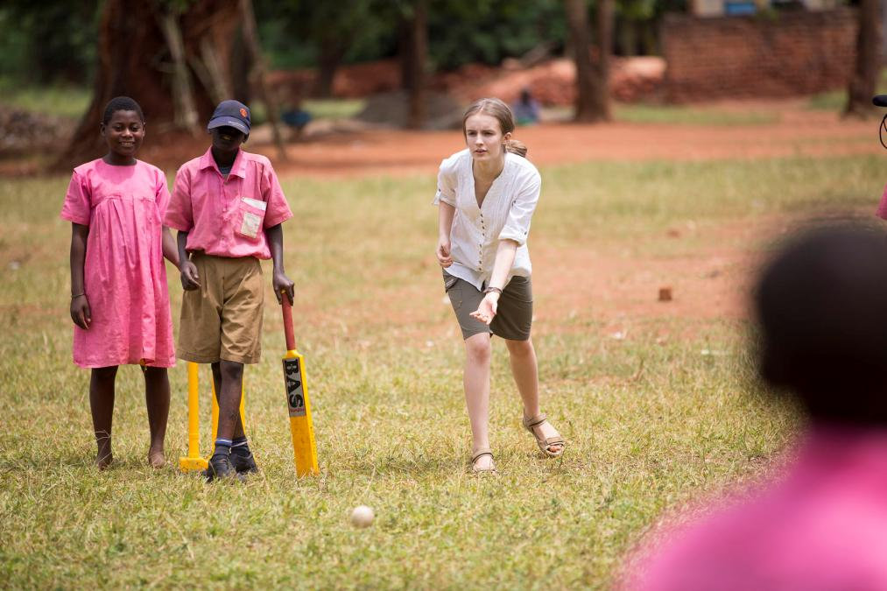
Then it was time for some games!
We had great fun playing cricket, using a ball that made a sound as it moved. It was clear that at Bishop Willis they were taught that having a disability should never hold you back!
It was an uplifting morning and we were left feeling inspired and educated – and ashamed of our cricketing skills!

Slide 16
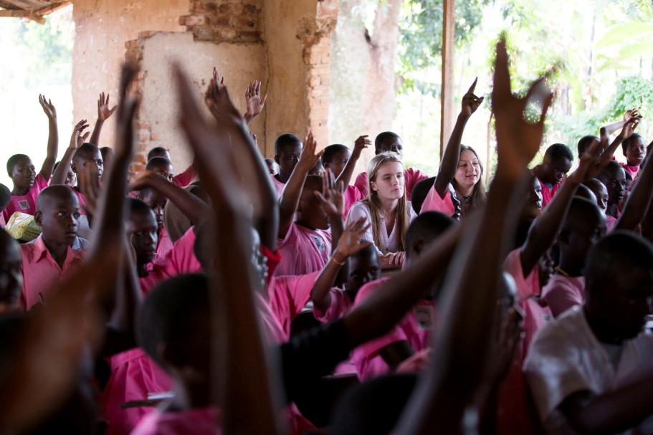
Iganga Secondary School was better equipped than the primary school. For example, the edges of paths were painted for the benefit of the visually impaired.
We spoke to a 17-year-old boy, Joseph, who was very ambitious. He wanted to become a lawyer or a journalist, and was determined to do well in his A levels. His vision is limited, but he would not let that stop him from trying his best to achieve his goals.

Slide 17
Day 5:
Meeting policy makers

Slide 18
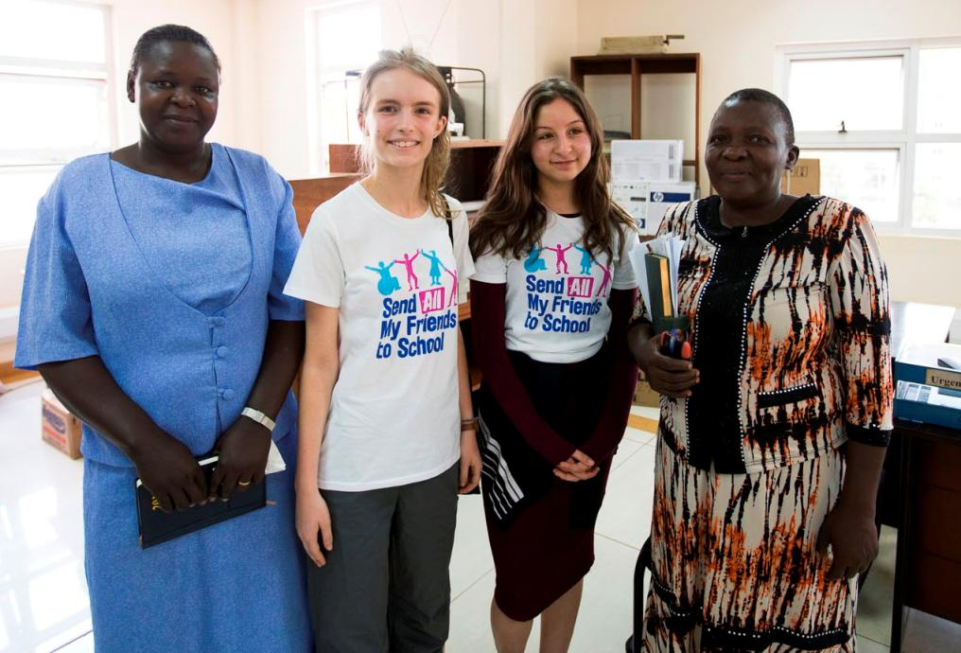
On our last day in Uganda, we met ministers of the special needs department within the Ministry of Education and Sports. We were impressed by their openness and honesty about the current situation regarding special needs education in Uganda.
The ministry’s budget for education is small – this is one of the key problems facing special needs education in Uganda.

Slide 19
Back home in the UK

Slide 20
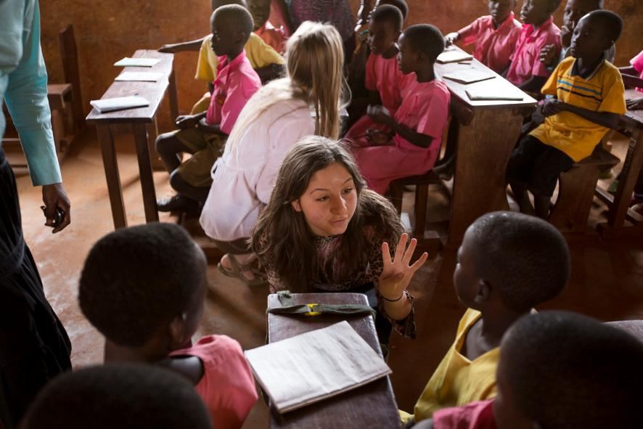
Maisie’s reflections
We heard about a number of barriers preventing some children with disabilities from getting an education. But there are grounds for optimism…Bishop Willis is an example of inclusive education in Uganda, and the Ministry of Education have new policies that promise to overcome barriers.
The biggest global waste of all is the loss of potential for these children. We must act to change things!

Slide 21
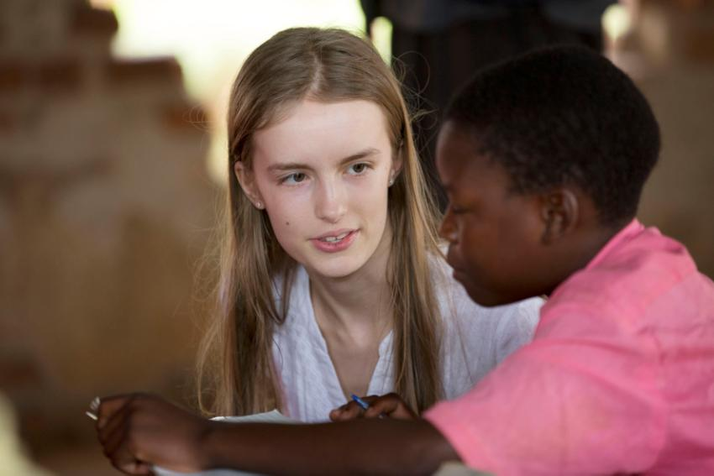
Rebecca’s reflections
I fully support inclusive education – with my own visual impairment I personally could not bear to have any other type of education.
Inclusive education offers mutual understanding and removal of any potential stigma attached to special needs.
I feel strongly that people should be more aware of how important it is for all children across the world to fulfil the right to education – we can all play a part in campaigning for that right!

Slide 22





With thanks to…
Photos © Graeme Robertson/GCE UK
This project is funded
by the European Union.

